Slide 1
3D Placement with D2D Vertical Connections
B10732014 何雨澂
B10732027 吳秉寰
B10715041 馬孝傑
B10732040 李宇哲

Slide 2
Flow
Global placement
Partition
Cell Legalization
Detail Placement
Terminal Placement

Slide 3
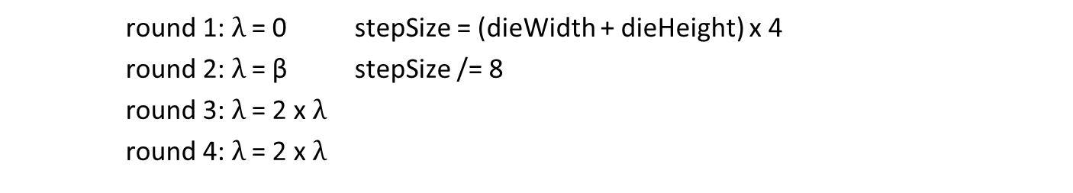
Global Placement (1/3)
Use the gradient method to solve the objective function
$$\min{ W\left(x,y\right)+}\text{λ}\sum{{(D\left(x,y\right)−Mb)}^{2}}$$
wirelength
density
By the "λ" increasing round by round
round 1: $\text{λ}$ = 0 stepSize = (dieWidth + dieHeight) x 4
round 2: $\text{λ}$ = β stepSize /= 8
round 3: $\text{λ}$ = 2 x $\text{λ}$
round 4: $\text{λ}$ = 2 x $\text{λ}$

Slide 4
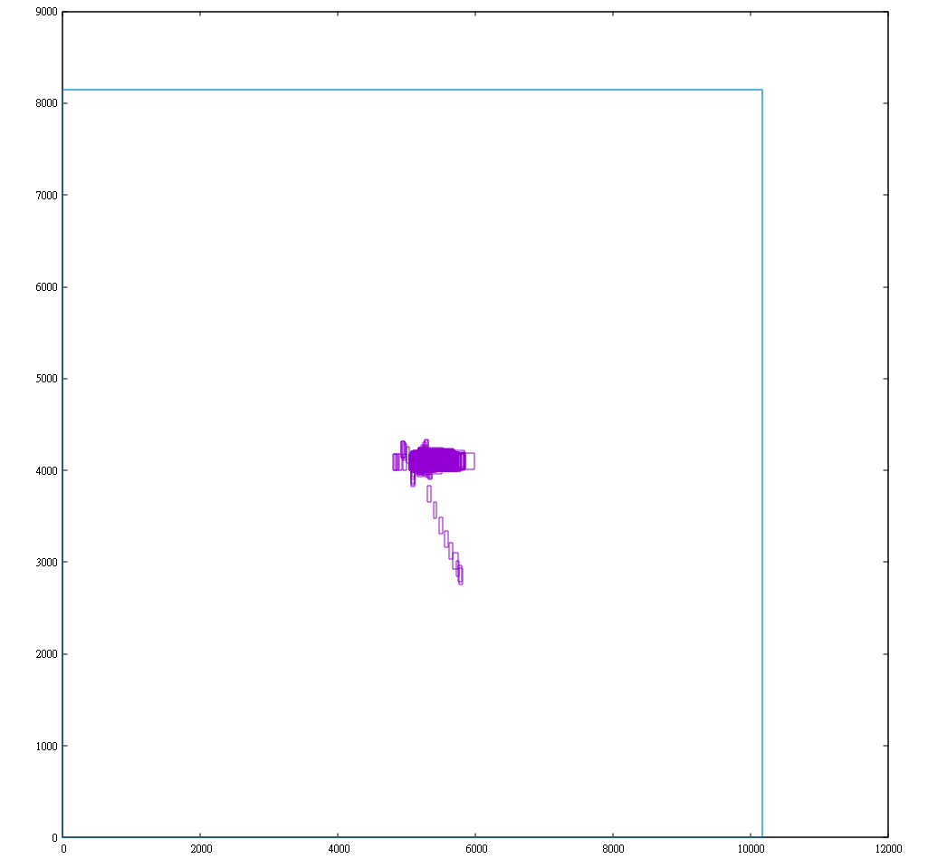
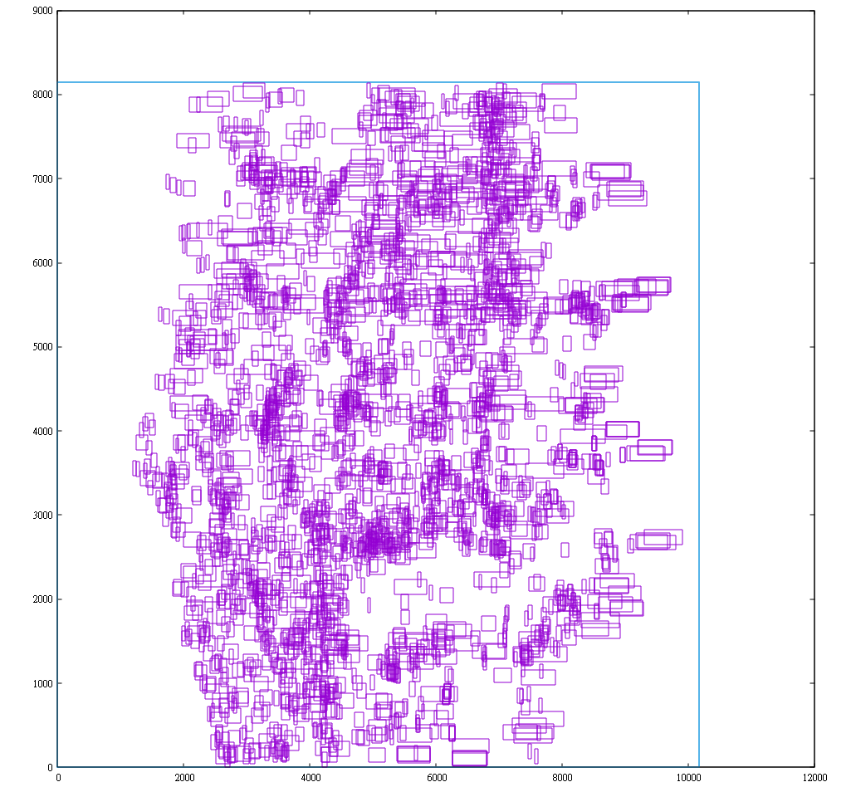
Global Placement (2/3)

Slide 5
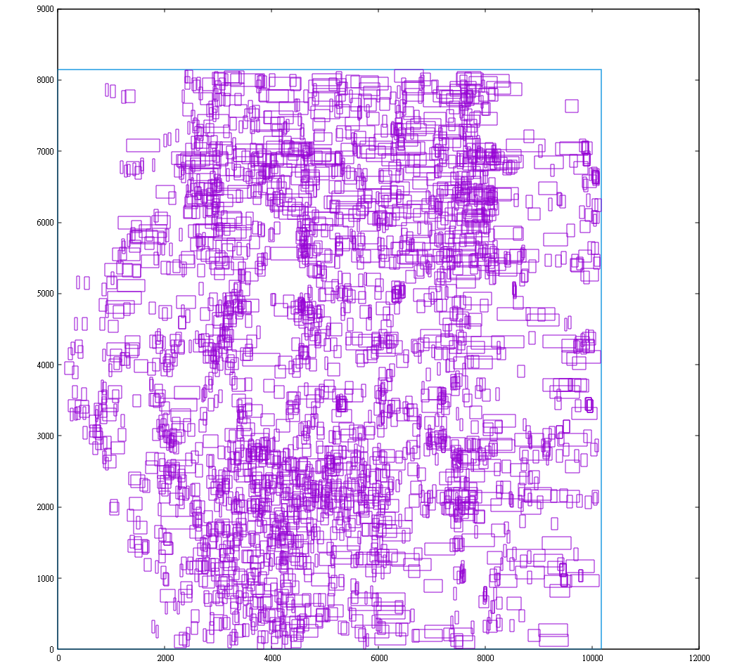
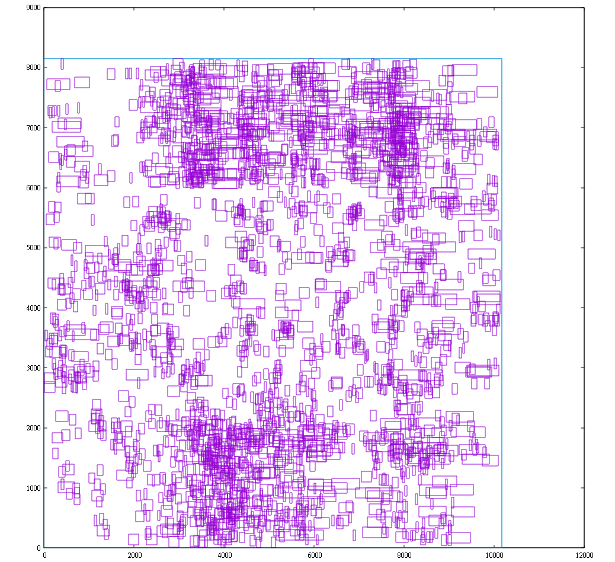
Global Placement (3/3)

Slide 6
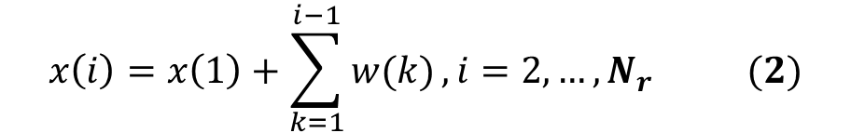
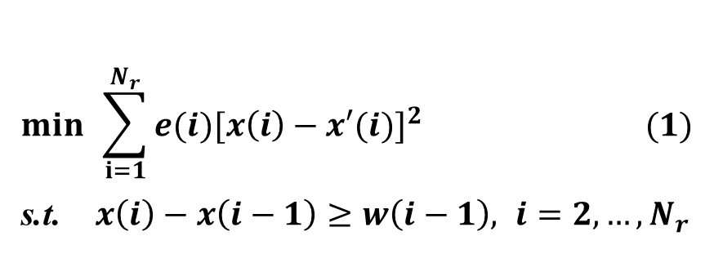
Cell Legalization (1/2)
Solve quadratic program based on one linear equation
Assuming ‘=’ constraint
$$\min{ }\sum_{i=1}^{N_{r}}{{e(i)[x\left(i\right)−x′(i)]}^{2}} (1)$$
s.t. $x\left(i\right)−x\left(i−1\right)≥w\left(i−1\right), i=2, …,N_{r}$
$$x\left(i\right)=x\left(1\right)+\sum_{k=1}^{i−1}{w(k)}, i=2, …, N_{r} (2)$$

Slide 7
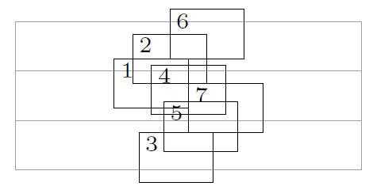
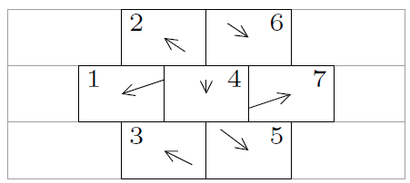
Cell Legalization (2/2)
Partition netlist into two dies with minimal terminals
Sort cells according to x-position
Dynamic programming
Insert each cell to rows
Determine the best row
Collapse clusters if there is overlap

Slide 8
Detailed Placement (1/9)
Classify instances with their location (die and row)
Cells in each row are sorted by their coordinate
Row N
…
Row 2
Row 1
Row 0
(cells in row N)
(cells)
(cells in row 2)
(cells in row 1)
(cells in row 0)
Top Die

Slide 9
Detailed Placement (2/9)
In each row, construct segments by selecting three consecutive instances
Segments are independent
a segment
another segment

Slide 10
Detailed Placement (3/9)
Adjust segments’ size
Too wide
Smaller
&
Too wide
(separate)

Slide 11
Detailed Placement (4/9)
For each segment, do DFS branch-and-bound (red→blue)
Initialize “best_WL” by the HPWL before DP
Step size
A segment
If the red cell is placed here
Then the blue cell can be placed here

Slide 12
Detailed Placement (5/9)
For each segment, do DFS branch-and-bound (red→blue)
Initialize “best_WL” by the HPWL before DP
Step size
A segment
Then the blue cell can be placed here
The red cell moves to another place

Slide 13
Detailed Placement (6/9)
For each segment, do DFS branch-and-bound (red→blue)
Initialize “best_WL” by the HPWL before DP
Step size
A segment
Then the blue cell can be placed here
When the red cell goes here

Slide 14
Detailed Placement (7/9)
For each segment, do DFS branch-and-bound (red→blue)
Initialize “best_WL” by the HPWL before DP
Step size
A segment
If the red cell moves here and the HPWL is larger than the recorded one, then we should move the red cell to the next place without giving the blue cell a try
*Note: cells haven’t placed yet doesn’t need to be referenced while calculating HPWL

Slide 15
Detailed Placement (8/9)
For each segment, do DFS branch-and-bound (red→blue)
Initialize “best_WL” by the HPWL before DP
Step size
A segment
If all cells are placed and the HPWL is better than “best_WL”, than refresh “best_WL” and record the positions of cells

Slide 16
Detailed Placement (9/9)
Result (final HPWL)
Running detailed placement for 1 iteration
 | Without DP | With DP | reduction
case1 | 123 | 118 | 4%
case2 | 10272799 | 10076549 | 2.5%

Slide 17
Terminal Placement (1/2)
Find the best boundary to insert terminal
Scenario1: no axis overlap
Scenario2: one axis overlap
Scenario3: two axes overlap
Top Die
Top Die
Bottom Die
one axis overlap
Top Die
Bottom Die
no axis overlap
Bottom Die
two axes overlap

Slide 18
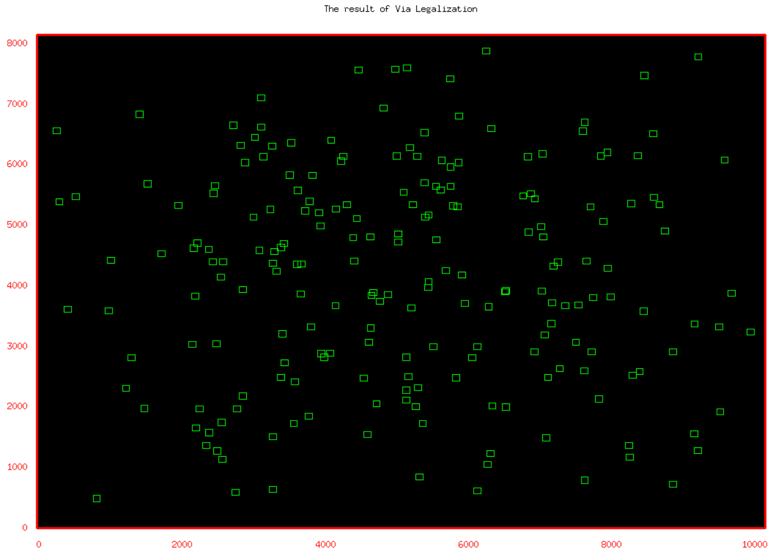

Terminal Placement (2/2)
Remove overlap between terminals
Build horizontal and vertical constraint graph
Transform to non-overlapping constraints
Solved by linear programming
Minimizing total displacement
lp_solve reference guide (sourceforge.net)

Slide 19
Thank you for listening!

